Slide 1
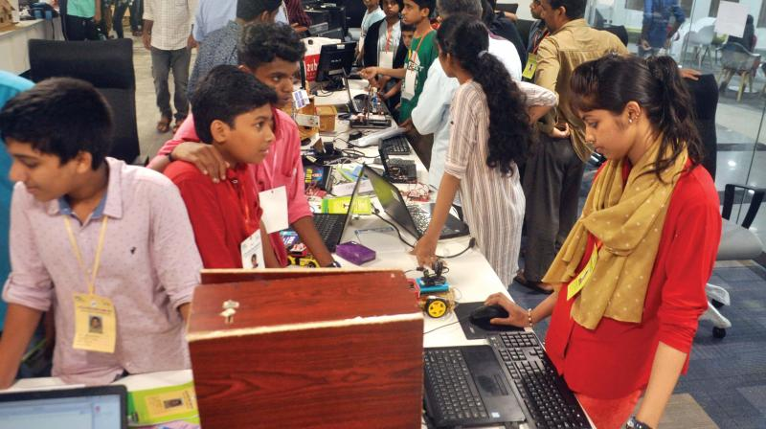
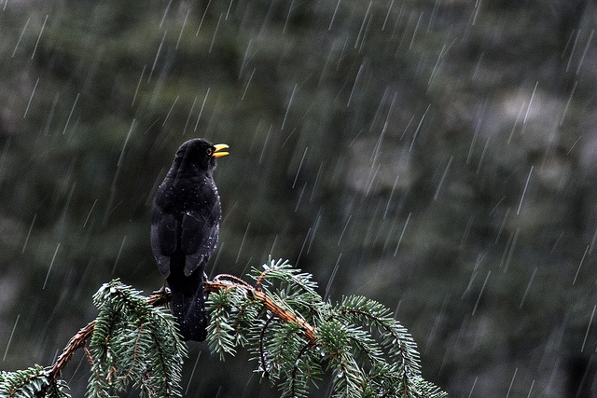
IMAGES
POETIC DEVICES
CONTENT

Slide 2
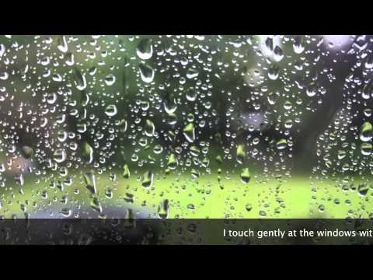
What image do you see in your mind when
you read the given sentences?
I am dotted silver threads
I am beautiful pearls.
I descent and embrace the flowers
Poetic devices
content

Slide 3

Visual Image
Vivid descriptive language that appeals to one through sight.
Poetic divices
content

Slide 4
AUDITORY IMAGE
POETIC DEVICES
CONTENT

Slide 5
What image do you see in your mind when
you read the given sentences?
The hills laugh
The voice of thunder
POETIC DEVICES
CONTENT

Slide 6

Auditory Image
Vivid descriptive language that appeals to one through hearing
POETIC DEVICES
CONTENT

Slide 7
TACTILE IMAGE
POETIC DEVICES
CONTENT

Slide 8
What image do you see in your mind when
you read the given sentences?
I touch gently at the windows
I descent and embrace the flowers.
POETIC DEVICES
CONTENT

Slide 9
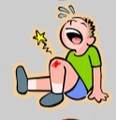
Tactile Image
Vivid descriptive language that appeals to one through touch or feel
POETIC DEVICES
CONTENT

Slide 10
OLFACTORY IMAGE
POETIC DEVICES
CONTENT

Slide 11
What image do you see in your mind when
you read the given sentences?
The smell of salty ocean air
The sweet lemony scent
POETIC DEVICES
ഉള്ളടക്കം
CONTENT

Slide 12

Olfactory image
Vivid descriptive language that appeals to one through smelling
POETIC DEVICES
CONTENT

Slide 13
What image do you see in your mind when
you read the given sentences?
The crab soup had a rich sea food flavor
The salty sweet flavour of salt water
POETIC DEVICES
ഉള്ളടക്കം
CONTENT

Slide 14

Gustatory Image
Vivid descriptive language that appeals to one through tasting
POETIC DEVICES
CONTENT

Slide 15
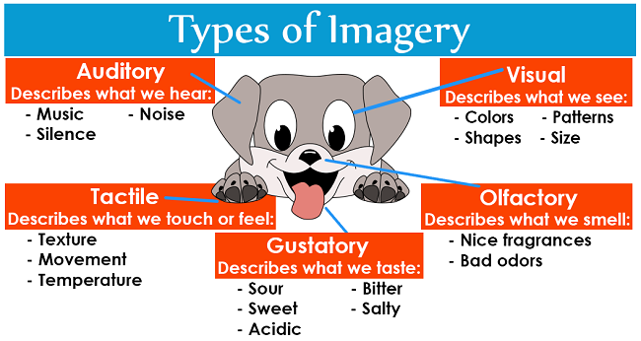
IMAGERY
POETIC DEVICES
CONTENT

